Slide 1

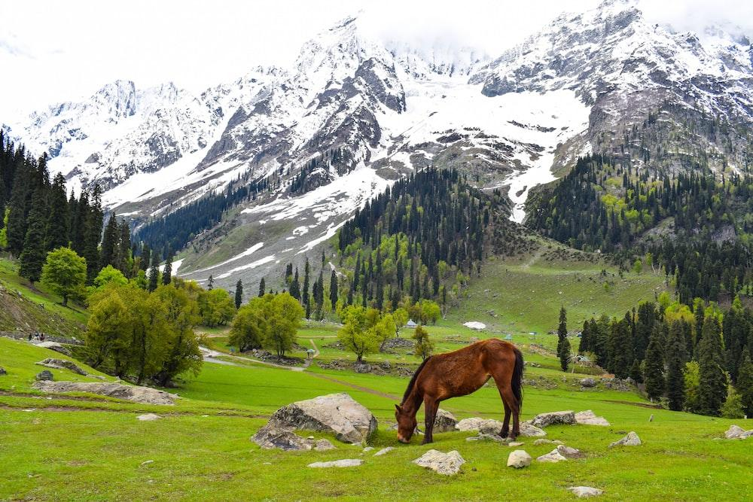
LIVESTOCK CENSUS OF INDIA:
GROUP PRESENTATION BY:
SIMRAH RAFIQI (RA2011003010348) - [F1]
POORVI MITTAL (RA2011003010361) - [F1]

Slide 2

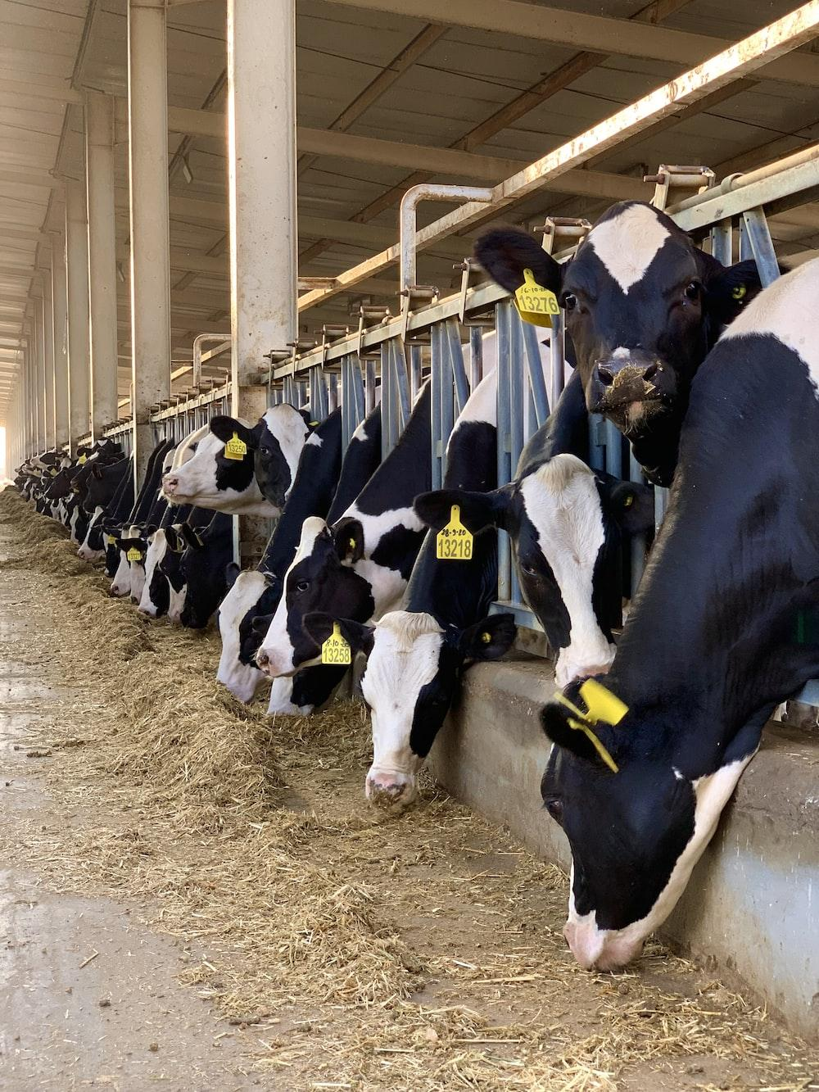
DATA SET SOURCE:
The dataset has been taken from Kaggle. The dataset consists of details about different livestocks in rural and urban combined at the state and district level.
The livestock Census is conducted every five years in India, and this dataset is the result of the 20th livestock census conducted in 2019.
We have tried to find various insights analyzing the dataset, like Which state has the largest population of different livestock animals, which can further tell us about the largest producer of poultry, milk, and wool, etc. We are also trying to see what are the distribution of animals in the majority of districts in India, and what districts are outliers.

Slide 3
PARAMETERS:
VARIABLE | VARIABLE TYPE | DESCRIPTION
district_name | Categorical | Various districts of India which contain different livestocks
ref_district_id | Numerical | ID representing different districts
state_name | Categorical | Shows different states containing livestock
animal_count | Numerical | Different animals present in states and districts
Total_poultry | Numerical | Total count of the livestock present in a particular state and district

Slide 4
STORYTELLING:
PROBLEM STATEMENT:
Despite advancements in technology and management practices, livestock farmers continue to face significant challenges in maximizing the productivity and profitability of their operations.Therefore, the objective of this study is to identify key factors that influence livestock productivity and health, and develop effective data analysis methodologies that can help farmers optimize their operations and improve their bottom line.

Slide 5
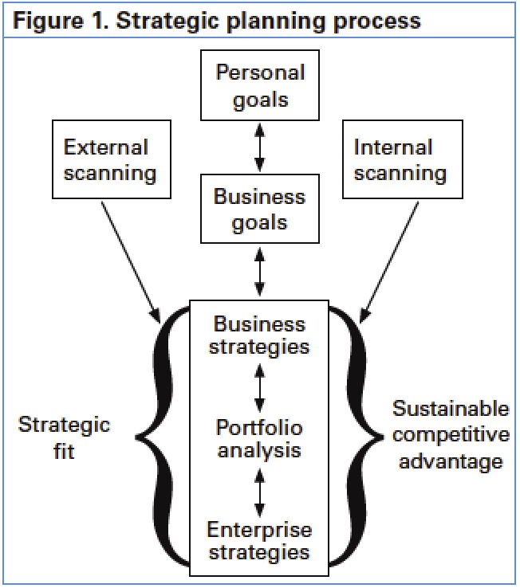
PLANNING AND POLICY
MAKING:
The dataset provides valuable information on the distribution and size of livestock populations across different states and districts in India. This information can help policymakers and government agencies to develop policies and plans to address the needs of different regions and populations and take necessary steps accordingly.

Slide 6
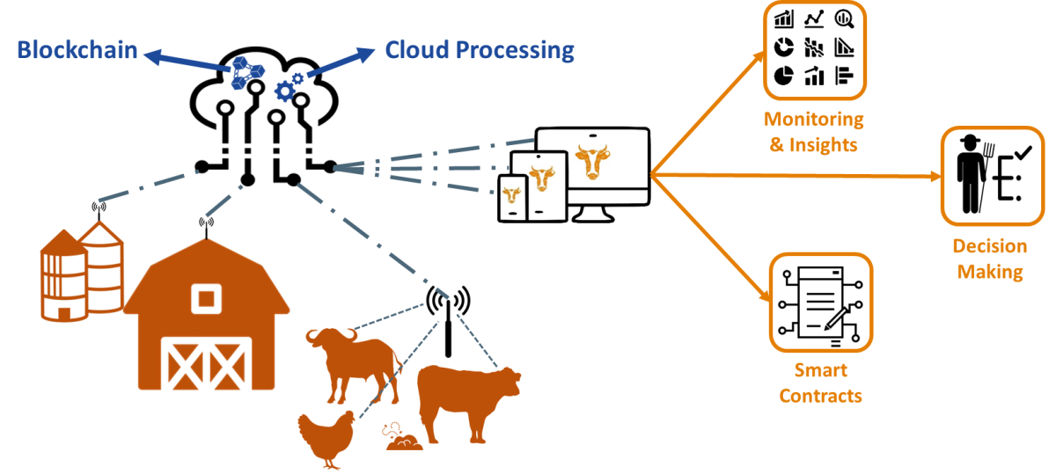
LIVESTOCK MANAGEMENT:
The dataset contains information on the age, gender, and breed of livestock, which can help livestock owners and managers to make informed decisions regarding breeding, feeding, and healthcare.

Slide 7
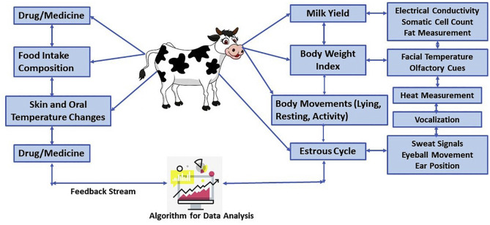
ECONOMIC ANALYSIS:
The dataset provides information on the economic value of livestock production in different regions and states of India. This information can be used to analyze the contribution of the livestock sector to the overall economy, as well as to identify opportunities for growth and development.

Slide 8
WHO WILL BE INTERESTED?

Slide 9
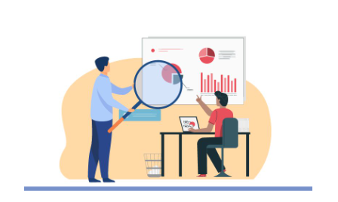
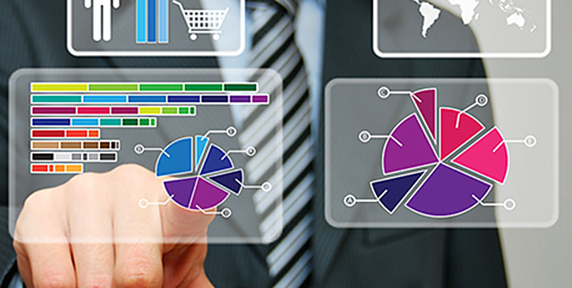
RESEARCHERS AND ANALYSTS
Researchers and analysts studying livestock and agriculture in India could be interested in the 20th Livestock Census in India dataset for several reasons. The dataset provides information on the size, distribution, and characteristics of India's livestock population, which can be used to analyze trends and patterns in livestock production and management. Researchers could also use the dataset to investigate the relationship between livestock rearing and agricultural productivity in different states and regions of India.

Slide 10

2) NGOs AND ORGANISATIONS
NGOs and other organizations working on issues related to livestock and rural livelihoods in India could be interested as, the dataset provides detailed information on the number and distribution of different types of livestock in different states of India, which could be useful for organizations working on livestock-related programs and interventions. By comparing the data from different time periods, organizations could assess the effectiveness of their interventions and make any necessary adjustments.Finally, the dataset could be used to raise awareness about the importance of livestock rearing in rural India and advocate for policies that support the growth and development of the livestock sector.

Slide 11
BUSINESS ORGANISATIONS
Investors and businesses interested in the livestock industry in India could be interested in the dataset a it provides valuable information on the size and distribution of the livestock population in India, which could be useful for identifying investment opportunities in the livestock industry.
The dataset provides insights into the changing trends in the livestock sector in India. By comparing the data from different time periods, investors and businesses could identify emerging trends and adjust their investment strategies accordingly.
The dataset can provide insights into the socio-economic and demographic aspects of rural India, which could be useful for businesses looking to understand the market conditions in rural areas.
The dataset could be used by businesses and investors to assess the potential risks associated with investing in the livestock industry in India.

Slide 12


